Slide 1
Extra Credit Project
MA 4635
Avinash Bissoondial

Slide 2
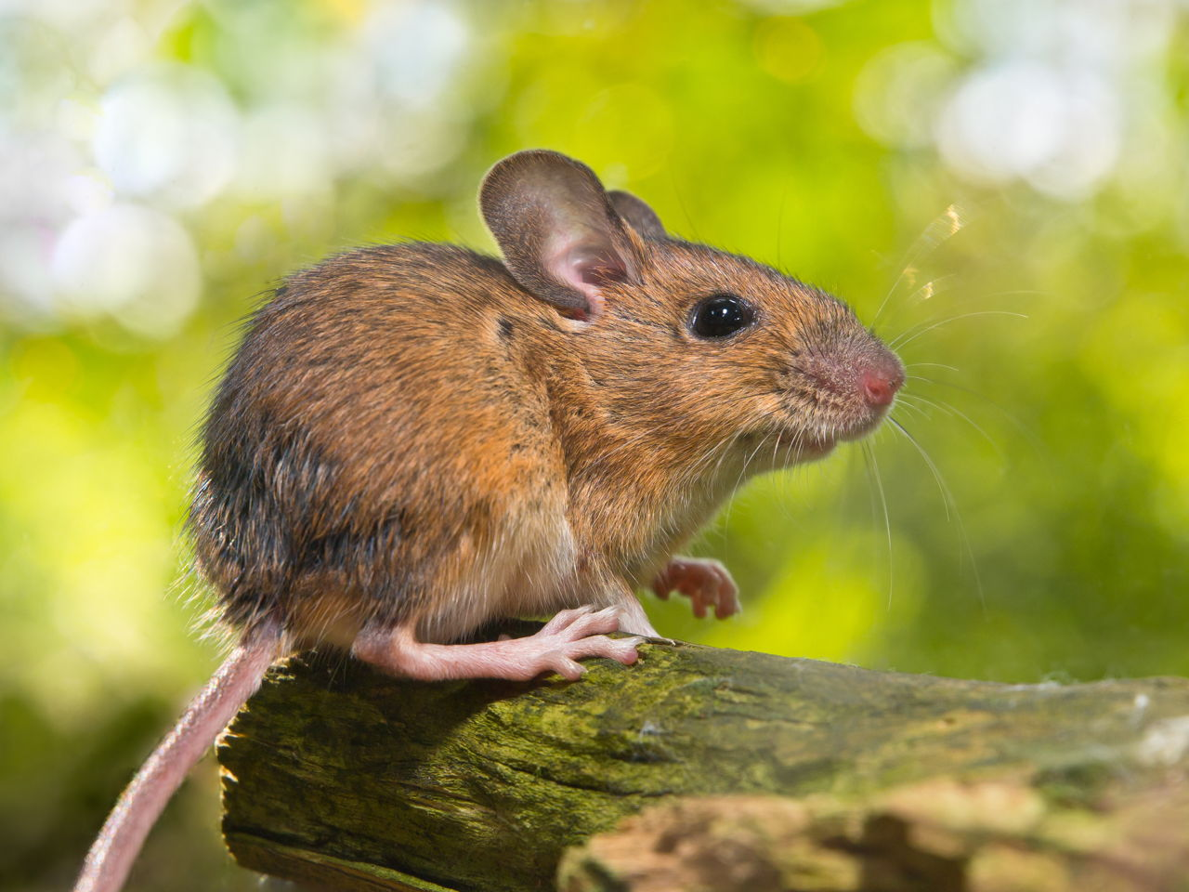
Where we left off - Dataset
Dataset is of mouse protein expression in the brain when it is exposed to different stimuli
Kaggle dataset with:
82 Features
1080 observations
8 classes
Memantine vs. Saline
Trisomic vs Control
Shock-Context vs Context-Shock

Slide 3
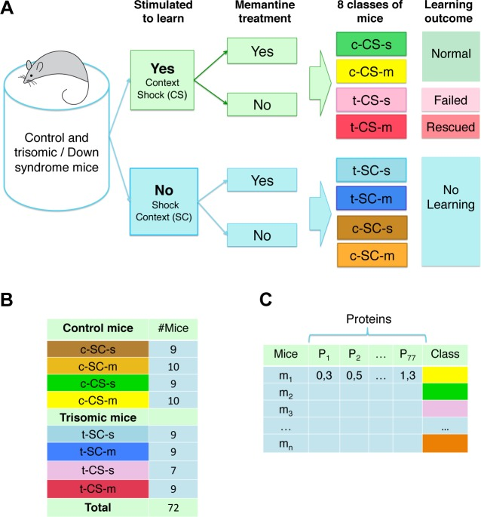

Slide 4
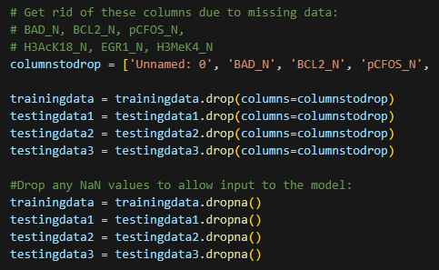
Where we left off - Feature Engineering
Split data into 70% training and 10% for one validation and two test sets
When looking at training data, there were a few features with many empty points
Caused dropping null values to eliminate many observations
As a solution, dropped columns with >30% null points
Still lost some data after dropping but had 663 observations for training data

Slide 5
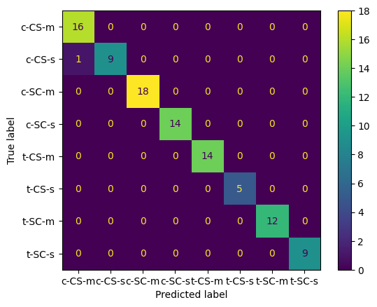
Where we left off - Model Performances
Best Models (Accuracy on third test set):
PCA + QDA: 98%
PCA + Random Forest: 98.9%
PCA + KNN: 97%
Confusion Matrix of Random Forest Model

Slide 6
Why such high accuracy?
Many features with considerably high or low correlation coefficients with the different classes
15 features outside of range [-0.4 to 0.4] for behavior (SC / CS)
7 features outside of range [-0.2 to 0.2] for Treatment (M / S)
1 feature above 0.5, 9 features outside [-0.2 to 0.2] for Genotype (T / C)

Slide 7
Implementing Neural Networks

Slide 8
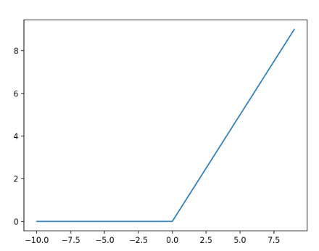
Scikit-learn Multilayer Perceptron
Edited four parameters:
Solver
Stochastic Gradient Descent, Adam, L-BFGS
Alpha
Parameter to adjust regularization (L2)
Activation function
Sigmoid, Tanh, ReLU
Hidden layer sizes
Also tried with and without PCA

Slide 9
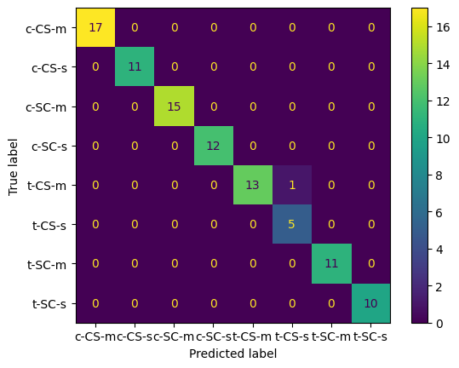
Scikit-learn Multilayer Perceptron
Accuracy: 98.9% (94/95)
Same as random forest
Not as many customization options as Pytorch models

Slide 10

Using Pytorch
Created simple MLP in PyTorch
2 Layer Neural Network w/ 75 hidden layers
Input, hidden layer, output
Used ReLU activation for first layer and Sigmoid activation for the second layer
Adjusted the following
Learning rate
Loss Function
Optimizer
Number of epochs

Slide 11
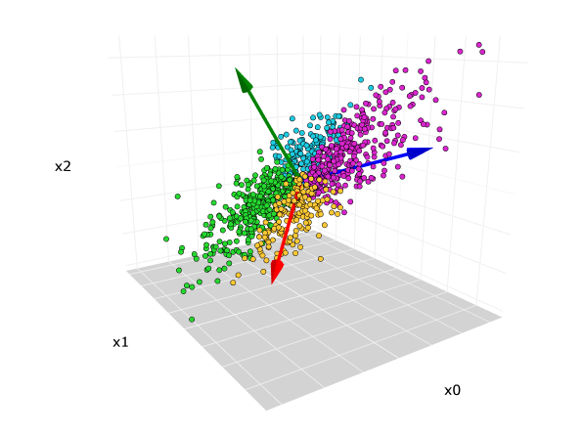
What worked?
Just like with other ML models, PCA was much more accurate
When increasing epochs accuracy went up to a certain point (300)
Slight learning rate increases worked with ideal amount around 0.2 - 0.3

Slide 12
Optimizers
* Accuracies calculated with Binary Cross Entropy loss function and 0.1 learning rate
Original: Stochastic gradient descent default param -> 96.2%
Adadelta algorithm -> 95.1%
Adagrad algorithm -> 92.4%
Adam algorithm -> 89.6%
AdamW algorithm -> 89.7%
Adamax algorithm -> 90%
ASGD (Average Stochastic gradient descent) -> 97.3%

Slide 13
Loss Functions
* Using SGD with a learning rate of 0.4, 5 runs each
Original: BCE -> 96% - 100%
Tried Mean absolute error -> performed worse
Mean Squared Error -> 92% - 100%
Cross Entropy Loss -> 93% - 100%
Hinge Embedding Loss -> 60% - 70%
Kullback-Leibler Divergence Loss -> 20%

Slide 14
Final Results
Neural Network using:
Learning rate of 0.3
300 Epochs
Binary Cross-Entropy Loss Function
Average Stochastic Gradient Descent
Average accuracy after 30 runs: 0.9995833039283752

Slide 15
Learning Outcomes
Importance of learning rate and # of epochs
Amount of customization in Neural Nets compared to traditional ML models
How to use PyTorch library and more knowledge about neural networks and how they work in general

Slide 16
Bibliography
https://www.datacamp.com/tutorial/pytorch-tutorial-building-a-simple-neural-network-from-scratch
https://neptune.ai/blog/pytorch-loss-functions

